Slide 1

Computer Operating Systems BLG 312E Week-7
Prof. Dr. Kemal Bıçakcı

Slide 2
Review of Last Week

Slide 3
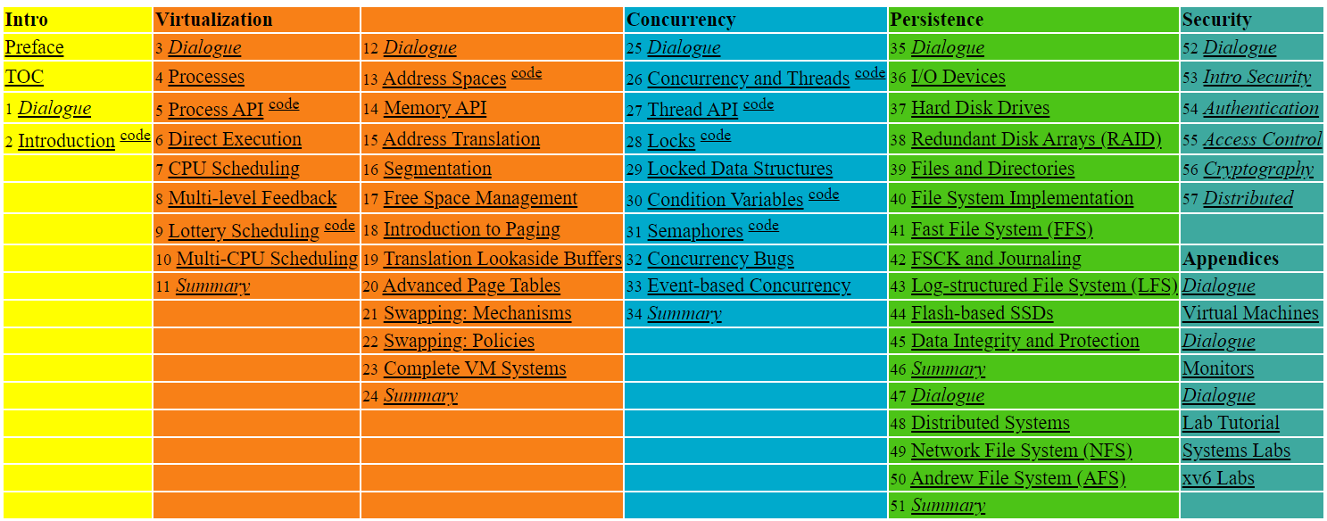

Slide 4
26. Concurrency: An Introduction
Operating System: Three Easy Pieces

Slide 5
Thread
A new abstraction for a single running process
Multi-threaded program
A multi-threaded program has more than one point of execution.
Multiple PCs (Program Counter)
They share the same address space.

Slide 6
Why We Use Threads?
Parallelism (on a system with multiple processors)
Example: A program that performs operations on very large arrays
To avoid blocking program progress due to slow I/O
While one thread in your program waits, the CPU scheduler can switch to other threads.
Threads enables overlap of I/O with other activities within a single program, much like multiprogramming did for processes across programs
Why do we use threads instead of processes?

Slide 7
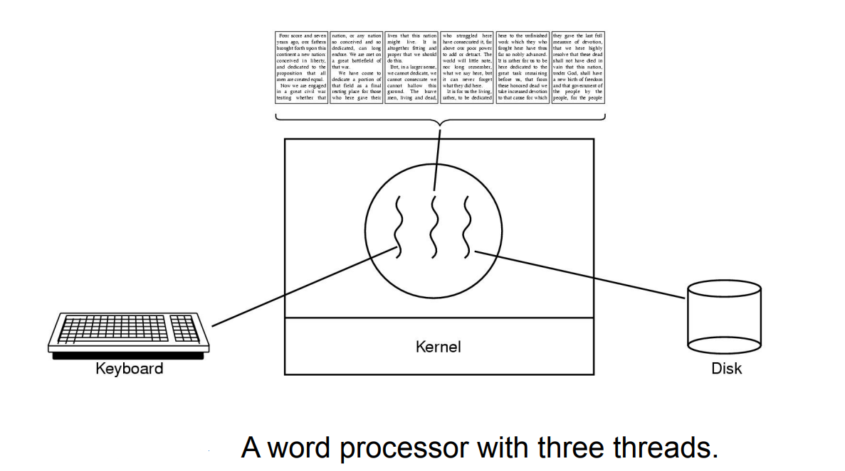

Slide 8
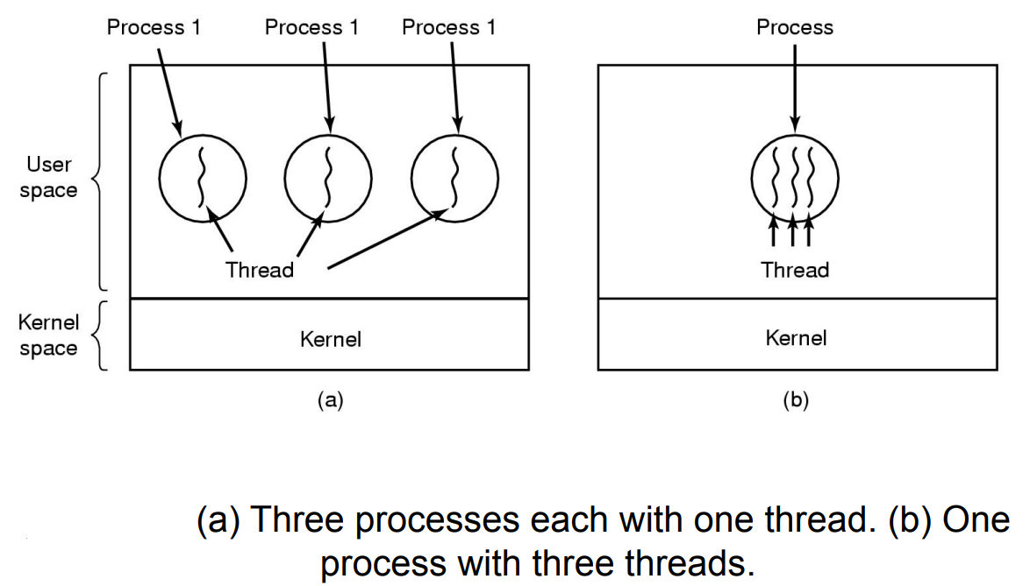

Slide 9
Context Switch between threads
Each thread has its own program counter and set of registers.
One or more thread control blocks (TCBs) are needed to store the state of each thread.
When switching from running one (T1) to running the other (T2),
The register state of T1 be saved.
The register state of T2 restored.
The address space remains the same.

Slide 10
The stack of the relevant thread
There will be one stack per thread.
0KB
The code segment:
where instructions live
0KB
Program Code
Program Code
1KB
1KB
Heap
The heap segment: contains malloc’d data dynamic data structures (it grows downward)
Heap
2KB
2KB
(free)
(free)
Stack (2)
(it grows upward)
The stack segment: contains local variables arguments to routines, return values, etc.
(free)
15KB
15KB
Stack (1)
Stack (1)
16KB
16KB
A Single-Threaded
Address Space
Two threaded
Address Space

Slide 11
Race condition
Example with two threads
counter = counter + 1 (default is 50)
We expect the result is 52. However,
(after instruction)
OS
Thread1
Thread2
PC
%eax
counter
before critical section
mov 0x8049a1c, %eax
add $0x1, %eax
100
105
108
0
50
51
50
50
50
interrupt
save T1’s state
restore T2’s state
100
105
108
113
0
50
51
51
50
50
50
51
mov 0x8049a1c, %eax
add $0x1, %eax
mov %eax, 0x8049a1c
interrupt
save T2’s state
restore T1’s state
108
113
51
51
50
51
mov %eax, 0x8049a1c

Slide 12
Critical section
A piece of code that accesses a shared variable and must not be concurrently executed by more than one thread.
Multiple threads executing the critical section can result in a race condition.
Need to support atomicity for critical sections (mutual exclusion)

Slide 13
Locks
Ensure that any such critical section executes as if it were a single atomic instruction (execute a series of instructions atomically).
1 lock_t mutex;
2 . . .
3 lock(&mutex);
4 balance = balance + 1;
5 unlock(&mutex);
Critical section

Slide 14
Another Type of Interaction
Accessing shared variables and the need to support atomicity for critical sections is not the only type of interaction between threads.
Another common interaction: One thread must wait for another to complete some action before it continues.
More on this later.

Slide 15
Why in OS Class?

Slide 16
27. Interlude: Thread API
Operating System: Three Easy Pieces

Slide 17
Thread API
Here, we cover the main portions of the thread API.
Each part will be explained further in the subsequent chapters.
This chapter is thus better used as a reference.

Slide 18
Thread Creation
How to create and control threads in POSIX?
thread: Used to interact with this thread.
attr: Used to specify any attributes this thread might have.
Stack size, Scheduling priority, …
start_routine: the function this thread starts running in.
arg: the argument to be passed to the function (start routine)
a void pointer allows us to pass in any type of argument.
#include <pthread.h>
int
pthread_create( pthread_t * thread,
const pthread_attr_t * attr,
void * (*start_routine)(void*),
void * arg);

Slide 19
Thread Creation (Cont.)
If start_routine instead required another type argument, the declaration would look like this:
An integer argument:
Return an integer:
int
pthread_create(…, // first two args are the same
void* (*start_routine)(int),
int arg);
int
pthread_create(…, // first two args are the same
int (*start_routine)(void*),
void* arg);

Slide 20
Example: Creating a Thread
#include <pthread.h>
typedef struct __myarg_t {
int a;
int b;
} myarg_t;
void *mythread(void *arg) {
myarg_t *m = (myarg_t *) arg;
printf(“%d %d\n”, m->a, m->b);
return NULL;
}
int main(int argc, char *argv[]) {
pthread_t p;
int rc;
myarg_t args;
args.a = 10;
args.b = 20;
rc = pthread_create(&p, NULL, mythread, &args);
…
}

Slide 21
Wait for a thread to complete
int pthread_join(pthread_t thread, void **value_ptr);
thread: Specify which thread to wait for
value_ptr: A pointer to the return value
Because pthread_join() routine changes the value, you need to pass in a pointer to that value.

Slide 22
Example: Waiting for Thread Completion
#include <stdio.h>
#include <pthread.h>
#include <assert.h>
#include <stdlib.h>
typedef struct __myarg_t {
int a;
int b;
} myarg_t;
typedef struct __myret_t {
int x;
int y;
} myret_t;
void *mythread(void *arg) {
myarg_t *m = (myarg_t *) arg;
printf(“%d %d\n”, m->a, m->b);
myret_t *r = malloc(sizeof(myret_t));
r->x = 1;
r->y = 2;
return (void *) r;
}

Slide 23
Example: Waiting for Thread Completion (Cont.)
int main(int argc, char *argv[]) {
int rc;
pthread_t p;
myret_t *m;
myarg_t args;
args.a = 10;
args.b = 20;
pthread_create(&p, NULL, mythread, &args);
pthread_join(p, (void **) &m); // this thread has been // waiting inside of the // pthread_join() routine.
printf(“returned %d %d\n”, m->x, m->y);
return 0;
}

Slide 24
Example: Dangerous code
Be careful with how values are returned from a thread.
When the variable r returns, it is automatically de-allocated.
void *mythread(void *arg) {
myarg_t *m = (myarg_t *) arg;
printf(“%d %d\n”, m->a, m->b);
myret_t r; // ALLOCATED ON STACK: BAD!
r.x = 1;
r.y = 2;
return (void *) &r;
}

Slide 25
Compare these two codes
void *mythread(void *arg) {
myarg_t *m = (myarg_t *) arg;
printf(“%d %d\n”, m->a, m->b);
myret_t *r = malloc(sizeof(myret_t)); // ALLOCATED ON HEAP
r->x = 1;
r->y = 2;
return (void *) r;
}
void *mythread(void *arg) {
myarg_t *m = (myarg_t *) arg;
printf(“%d %d\n”, m->a, m->b);
myret_t r; // ALLOCATED ON STACK: BAD!
r.x = 1;
r.y = 2;
return (void *) &r;
}

Slide 26
Example: Simpler Argument Passing to a Thread
Just passing in a single value
void *mythread(void *arg) {
int m = (int) arg;
printf(“%d\n”, m);
return (void *) (arg + 1);
}
int main(int argc, char *argv[]) {
pthread_t p;
int rc, m;
pthread_create(&p, NULL, mythread, (void *) 100);
pthread_join(p, (void **) &m);
printf(“returned %d\n”, m);
return 0;
}

Slide 27
Locks
Provide mutual exclusion to a critical section
Interface
Usage (w/o lock initialization and error check)
No other thread holds the lock → the thread will acquire the lock and enter the critical section.
If another thread hold the lock → the thread will not return from the call until it has acquired the lock.
int pthread_mutex_lock(pthread_mutex_t *mutex);
int pthread_mutex_unlock(pthread_mutex_t *mutex);
pthread_mutex_t lock;
pthread_mutex_lock(&lock);
x = x + 1; // or whatever your critical section is
pthread_mutex_unlock(&lock);

Slide 28
Locks (Cont.)
All locks must be properly initialized.
One way: using PTHREAD_MUTEX_INITIALIZER
The dynamic way: using pthread_mutex_init()
pthread_mutex_t lock = PTHREAD_MUTEX_INITIALIZER;
int rc = pthread_mutex_init(&lock, NULL);
assert(rc == 0); // always check success!

Slide 29
Locks (Cont.)
Check errors code when calling lock and unlock
An example wrapper
These two calls are also used in lock acquisition:
trylock: return failure if the lock is already held
timelock: return after a timeout
// Use this to keep your code clean but check for failures
// Only use if exiting program is OK upon failure
void Pthread_mutex_lock(pthread_mutex_t *mutex) {
int rc = pthread_mutex_lock(mutex);
assert(rc == 0);
}
int pthread_mutex_trylock(pthread_mutex_t *mutex);
int pthread_mutex_timelock(pthread_mutex_t *mutex,
struct timespec *abs_timeout);

Slide 30
Condition Variables
Condition variables are useful when some kind of signaling must take place between threads.
pthread_cond_wait:
Put the calling thread to sleep.
Wait for some other thread to signal it.
pthread_cond_signal:
Unblock at least one of the threads that are blocked on the condition variable
int pthread_cond_wait(pthread_cond_t *cond,
pthread_mutex_t *mutex);
int pthread_cond_signal(pthread_cond_t *cond);

Slide 31
Condition Variables (Cont.)
A thread calling wait routine:
The wait call releases the lock when putting said caller to sleep.
Before returning after being woken, the wait call re-acquire the lock.
A thread calling signal routine:
pthread_mutex_t lock = PTHREAD_MUTEX_INITIALIZER;
pthread_cond_t cond = PTHREAD_COND_INITIALIZER;
pthread_mutex_lock(&lock);
while (ready == 0)
pthread_cond_wait(&cond, &lock);
pthread_mutex_unlock(&lock);
pthread_mutex_lock(&lock);
ready = 1;
pthread_cond_signal(&cond);
pthread_mutex_unlock(&lock);

Slide 32
Condition Variables (Cont.)
The waiting thread re-checks the condition in a while loop, instead of a simple if statement.
There are some pthread implementations that could spuriously wake up a waiting thread.
In such a case, without rechecking, the waiting thread thinks that the condition has changed even though it has not.

Slide 33
Condition Variables (Cont.)
Don’t ever do this.
A thread calling wait routine:
A thread calling signal routine:
It performs poorly in many cases. → just wastes CPU cycles.
It is error prone.
while(ready == 0)
; // spin
ready = 1;

Slide 34
Compiling and Running
To compile the code examples, you must include the header pthread.h
Explicitly link with the pthreads library, by adding the –pthread flag.
For more information,
prompt> gcc –o main main.c –Wall -pthread
man –k pthread

Slide 35
Thread API Guidelines
Keep it simple.
Minimize thread interactions.
Initialize locks and condition variables.
Check your return codes.
Be careful how you pass arguments to, and return values from, threads.
Each thread has its own stack.
Always use condition variables to signal between threads.
Use the manual pages.

Slide 36
28. Locks
Operating System: Three Easy Pieces

Slide 37
Locks: The Basic Idea
Ensure that any critical section executes as if it were a single atomic instruction.
An example: the canonical update of a shared variable
Add some code around the critical section
balance = balance + 1;
1 lock_t mutex; // some globally-allocated lock ‘mutex’
2 …
3 lock(&mutex);
4 balance = balance + 1;
5 unlock(&mutex);

Slide 38
Locks: The Basic Idea
Lock variable holds the state of the lock.
available (or unlocked or free)
No thread holds the lock.
acquired (or locked or held)
Exactly one thread holds the lock and presumably is in a critical section.

Slide 39
The semantics of the lock()
lock()
Try to acquire the lock.
If no other thread holds the lock, the thread will acquire the lock.
Enter the critical section.
This thread is said to be the owner of the lock.
Other threads are prevented from entering the critical section while the first thread that holds the lock is in there.

Slide 40
Pthread lock - mutex
The name that the POSIX library uses for a lock.
Used to provide mutual exclusion between threads.
We may be using different locks to protect different variables → Increase concurrency (a more fine-grained approach).
1 pthread_mutex_t lock = PTHREAD_MUTEX_INITIALIZER;
2
3 Pthread_mutex_lock(&lock); // wrapper for pthread_mutex_lock()
4 balance = balance + 1;
5 Pthread_mutex_unlock(&lock);

Slide 41
Building A Lock
Efficient locks provided mutual exclusion at low cost.
Building a lock needs some help from the hardware and the OS.

Slide 42
Evaluating Locks – Basic criteria
Mutual exclusion
Does the lock work, preventing multiple threads from entering a critical section?
Fairness
Does each thread contending for the lock get a fair shot at acquiring it once it is free? (Starvation)
Performance
The time overheads added by using the lock

Slide 43
Controlling Interrupts
Disable Interrupts for critical sections
One of the earliest solutions used to provide mutual exclusion
Invented for single-processor systems.
Problem:
Require too much trust in applications
Greedy (or malicious) program could monopolize the processor.
Do not work on multiprocessors
Code that masks or unmasks interrupts be executed slowly by modern CPUs
void lock() {
DisableInterrupts();
}
void unlock() {
EnableInterrupts();
}

Slide 44
Why hardware support needed?
First attempt: Using a flag denoting whether the lock is held or not.
The code below has problems.
typedef struct __lock_t { int flag; } lock_t;
void init(lock_t *mutex) {
// 0 → lock is available, 1 → held
mutex->flag = 0;
}
void lock(lock_t *mutex) {
while (mutex->flag == 1) // TEST the flag
; // spin-wait (do nothing)
mutex->flag = 1; // now SET it !
}
void unlock(lock_t *mutex) {
mutex->flag = 0;
}

Slide 45
Why hardware support needed? (Cont.)
Problem 1: No Mutual Exclusion (assume flag=0 to begin)
Problem 2: Spin-waiting wastes time waiting for another thread.
So, we need an atomic instruction supported by Hardware!
test-and-set instruction, also known as atomic exchange
Thread1
Thread2
call lock()
while (flag == 1)
interrupt: switch to Thread 2
call lock()
while (flag == 1)
flag = 1;
interrupt: switch to Thread 1
flag = 1; // set flag to 1 (too!)

Slide 46
Test And Set (Atomic Exchange)
An instruction to support the creation of simple locks
return (Test) old value pointed to by the ptr.
Simultaneously update (Set) said value to new.
This sequence of operations is performed atomically.
int TestAndSet(int *ptr, int new) {
int old = *ptr; // fetch old value at ptr
*ptr = new; // store ‘new’ into ptr
return old; // return the old value
}

Slide 47
A Simple Spin Lock using test-and-set
typedef struct __lock_t {
int flag;
} lock_t;
void init(lock_t *lock) {
// 0 indicates that lock is available,
// 1 that it is held
lock->flag = 0;
}
void lock(lock_t *lock) {
while (TestAndSet(&lock->flag, 1) == 1)
; // spin-wait
}
void unlock(lock_t *lock) {
lock->flag = 0;
}
Note: To work correctly on a single processor, it requires a preemptive scheduler.

Slide 48
Evaluating Spin Locks
Correctness: yes
The spin lock only allows a single thread to entry the critical section.
Fairness: no
Spin locks don’t provide any fairness guarantees.
Indeed, a thread spinning may spin forever.
Performance:
In the single CPU, performance overheads can be quite painful.
If the number of threads roughly equals the number of CPUs, spin locks work reasonably well (presumably the critical section is short).

Slide 49
Compare-And-Swap
Test whether the value at the address (ptr) is equal to expected.
If so, update the memory location pointed to by ptr with the new value.
In either case, return the actual value at that memory location.
int CompareAndSwap(int *ptr, int expected, int new) {
int actual = *ptr;
if (actual == expected)
*ptr = new;
return actual;
}
Compare-and-Swap hardware atomic instruction (C-style)
void lock(lock_t *lock) {
while (CompareAndSwap(&lock->flag, 0, 1) == 1)
; // spin
}
Spin lock with compare-and-swap

Slide 50
Load-Linked and Store-Conditional
int LoadLinked(int *ptr) {
return *ptr;
}
int StoreConditional(int *ptr, int value) {
if (no one has updated *ptr since the LoadLinked to this address) {
*ptr = value;
return 1; // success!
} else {
return 0; // failed to update
}
}
The store-conditional only succeeds if no intermittent store to the address has taken place.
success: return 1 and update the value at ptr to value.
fail: the value at ptr is not updated and 0 is returned.
Load-linked And Store-conditional

Slide 51
Load-Linked and Store-Conditional (Cont.)
void lock(lock_t *lock) {
while (1) {
while (LoadLinked(&lock->flag) == 1)
; // spin until it’s zero
if (StoreConditional(&lock->flag, 1) == 1)
return; // if set-it-to-1 was a success: all done
otherwise: try it all over again
}
}
void unlock(lock_t *lock) {
lock->flag = 0;
}
Using LL/SC To Build A Lock
void lock(lock_t *lock) {
while (LoadLinked(&lock->flag)||!StoreConditional(&lock->flag, 1))
; // spin
}
A more concise form of the lock() using LL/SC

Slide 52
Fetch-And-Add
Atomically increment a value while returning the old value at a particular address.
int FetchAndAdd(int *ptr) {
int old = *ptr;
*ptr = old + 1;
return old;
}
Fetch-And-Add Hardware atomic instruction (C-style)

Slide 53
Ticket Lock
Ticket lock can be built with fetch-and add.
Ensure progress for all threads. → fairness
typedef struct __lock_t {
int ticket;
int turn;
} lock_t;
void lock_init(lock_t *lock) {
lock->ticket = 0;
lock->turn = 0;
}
void lock(lock_t *lock) {
int myturn = FetchAndAdd(&lock->ticket);
while (lock->turn != myturn)
; // spin
}
void unlock(lock_t *lock) {
FetchAndAdd(&lock->turn);
}

Slide 54
So Much Spinning
Hardware-based spin locks are simple and they work.
In some cases, these solutions can be quite inefficient.
Any time a thread gets caught spinning, it wastes an entire time slice doing nothing but checking a value.
How To Avoid Spinning?
We’ll need OS Support too!

Slide 55
A Simple Approach: Just Yield
When you are going to spin, give up the CPU to another thread.
OS system call moves the caller from the running state to the ready state.
The cost of a context switch can be substantial and the starvation problem still exists.
void init() {
flag = 0;
}
void lock() {
while (TestAndSet(&flag, 1) == 1)
yield(); // give up the CPU
}
void unlock() {
flag = 0;
}
Lock with Test-and-set and Yield

Slide 56
Using Queues: Sleeping Instead of Spinning
Queue to keep track of which threads are waiting to enter the lock.
park()
Put a calling thread to sleep
unpark(threadID)
Wake a particular thread as designated by threadID.

Slide 57
Using Queues: Sleeping Instead of Spinning
typedef struct __lock_t { int flag; int guard; queue_t *q; } lock_t;
void lock_init(lock_t *m) {
m->flag = 0;
m->guard = 0;
queue_init(m->q);
}
void lock(lock_t *m) {
while (TestAndSet(&m->guard, 1) == 1)
; // acquire guard lock by spinning
if (m->flag == 0) {
m->flag = 1; // lock is acquired
m->guard = 0;
} else {
queue_add(m->q, gettid());
m->guard = 0;
park();
}
}
…
Lock With Queues, Test-and-set, Yield, And Wakeup

Slide 58
Using Queues: Sleeping Instead of Spinning
void unlock(lock_t *m) {
while (TestAndSet(&m->guard, 1) == 1)
; // acquire guard lock by spinning
if (queue_empty(m->q))
m->flag = 0; // let go of lock; no one wants it
else
unpark(queue_remove(m->q)); // hold lock (for next thread!)
m->guard = 0;
}
Lock With Queues, Test-and-set, Yield, And Wakeup (Cont.)

Slide 59
Is there a race condition in this example code?

Slide 60
Wakeup/waiting race
In case the lock is released (by thread A) just before the call to park() (by thread B) → Thread B would sleep forever (potentially).
Solaris solves this problem by adding a third system call: setpark().
By calling this routine, a thread can indicate it is about to park.
If it happens to be interrupted and another thread calls unpark before park is actually called, the subsequent park returns immediately instead of sleeping.
queue_add(m->q, gettid());
setpark(); // new code
m->guard = 0;
park();
Code modification inside of lock()

Slide 61
void unlock(lock_t *m) {
while (TestAndSet(&m->guard, 1) == 1)
; // acquire guard lock by spinning
if (queue_empty(m->q))
m->flag = 0; // let go of lock; no one wants it
else
unpark(queue_remove(m->q)); // hold lock (for next thread!)
m->guard = 0;
}
Thread A
Lock With Queues, Test-and-set, Yield, And Wakeup (Cont.)

Slide 62
Using Queues: Sleeping Instead of Spinning
typedef struct __lock_t { int flag; int guard; queue_t *q; } lock_t;
void lock_init(lock_t *m) {
m->flag = 0;
m->guard = 0;
queue_init(m->q);
}
void lock(lock_t *m) {
while (TestAndSet(&m->guard, 1) == 1)
; // acquire guard lock by spinning
if (m->flag == 0) {
m->flag = 1; // lock is acquired
m->guard = 0;
} else {
queue_add(m->q, gettid());
m->guard = 0;
park();
}
}
…
Thread B
Lock With Queues, Test-and-set, Yield, And Wakeup

Slide 63
Futex
Linux provides a futex (similar to Solaris’s park and unpark).
futex_wait(address, expected)
Put the calling thread to sleep
If the value at address is not equal to expected, the call returns immediately.
futex_wake(address)
Wake one thread that is waiting on the queue.

